Slide 1
AVR Microcontroller and Embedded Electrovolt

Slide 2
Why AVR?

Slide 3
Requirements

Slide 4
Overview
Numbering and coding systems, history of AVR, feature and internal architecture
Introduction to AVR I/O interfacing and start simple projects (push bottom ,7segment and LCD)
AVR timers and event counter
AVR interrupts and writing interrupt handler
Serial data communication and RS232 interfacing
ADC chip and sensor

Slide 5
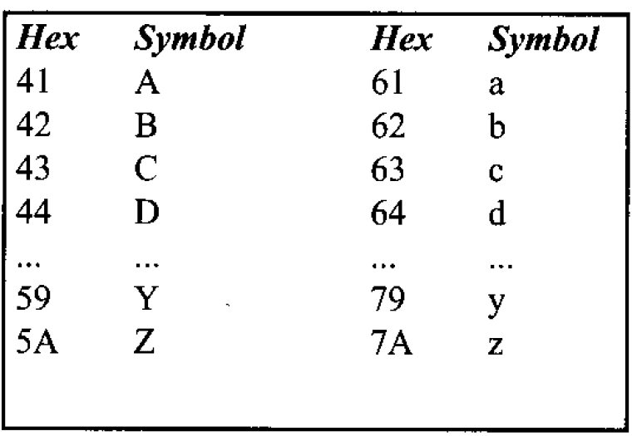
Numbering and coding systems
Decimal
3,144,197
Binary
0b11,0b1001000,0b11000101
Hexadecimal
0x03,0x90,0xC5
ASCII code

Slide 6
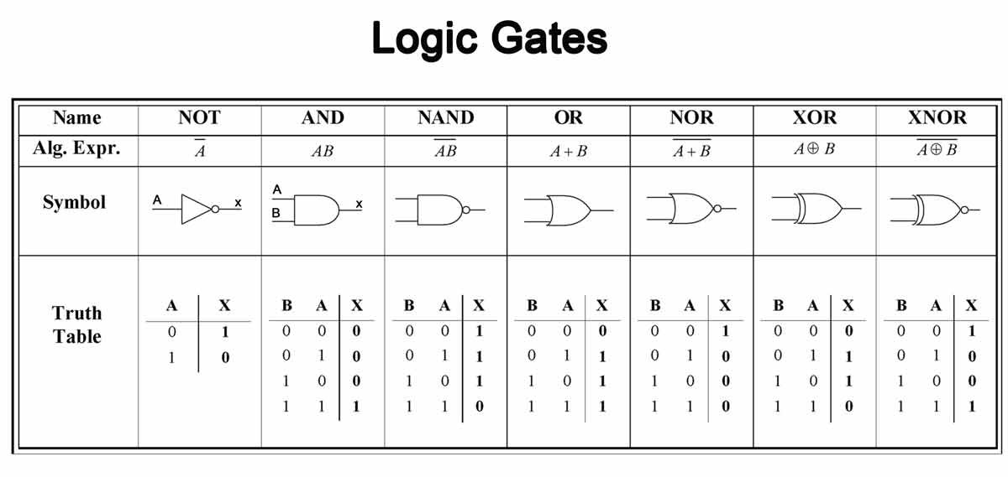
Logic gates

Slide 7
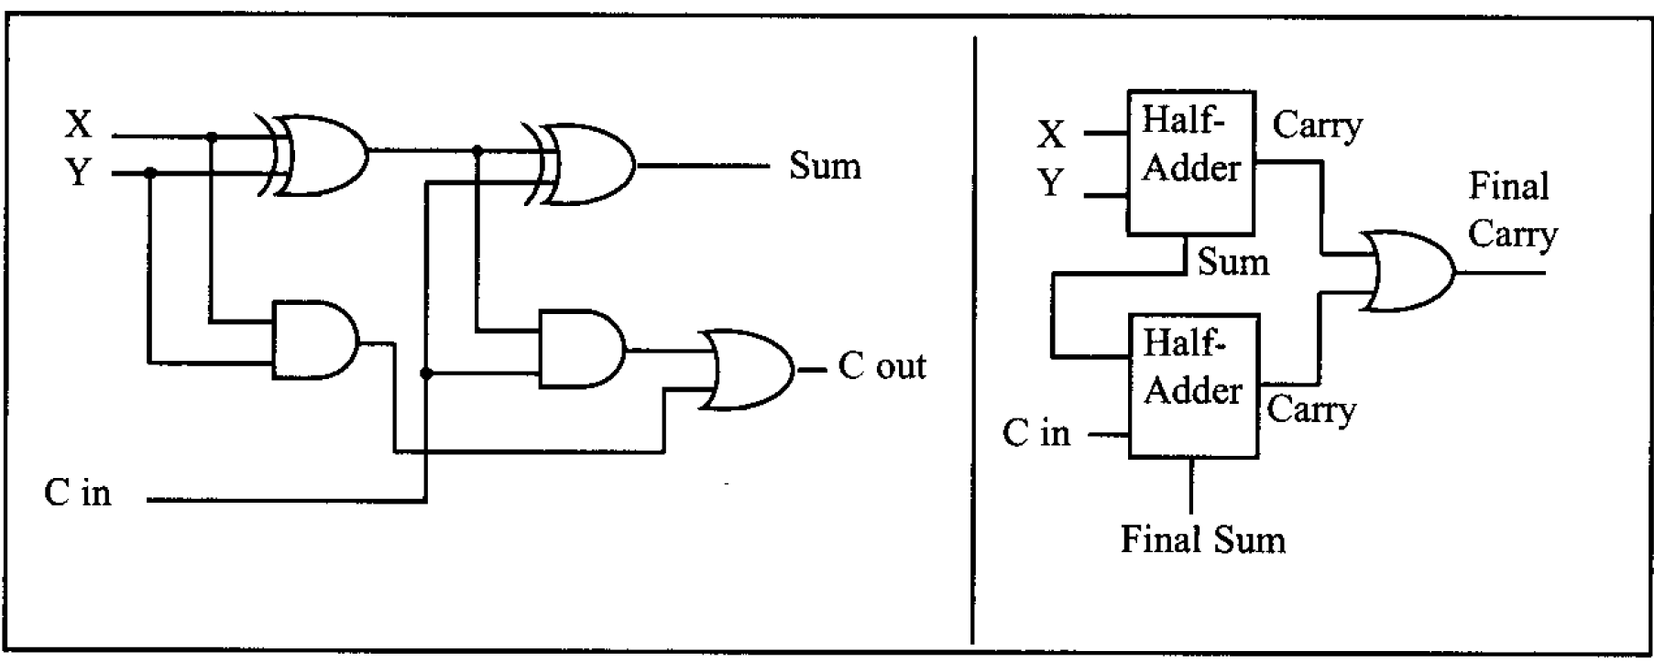
Logic design using gates
1-bit Full adder

Slide 8
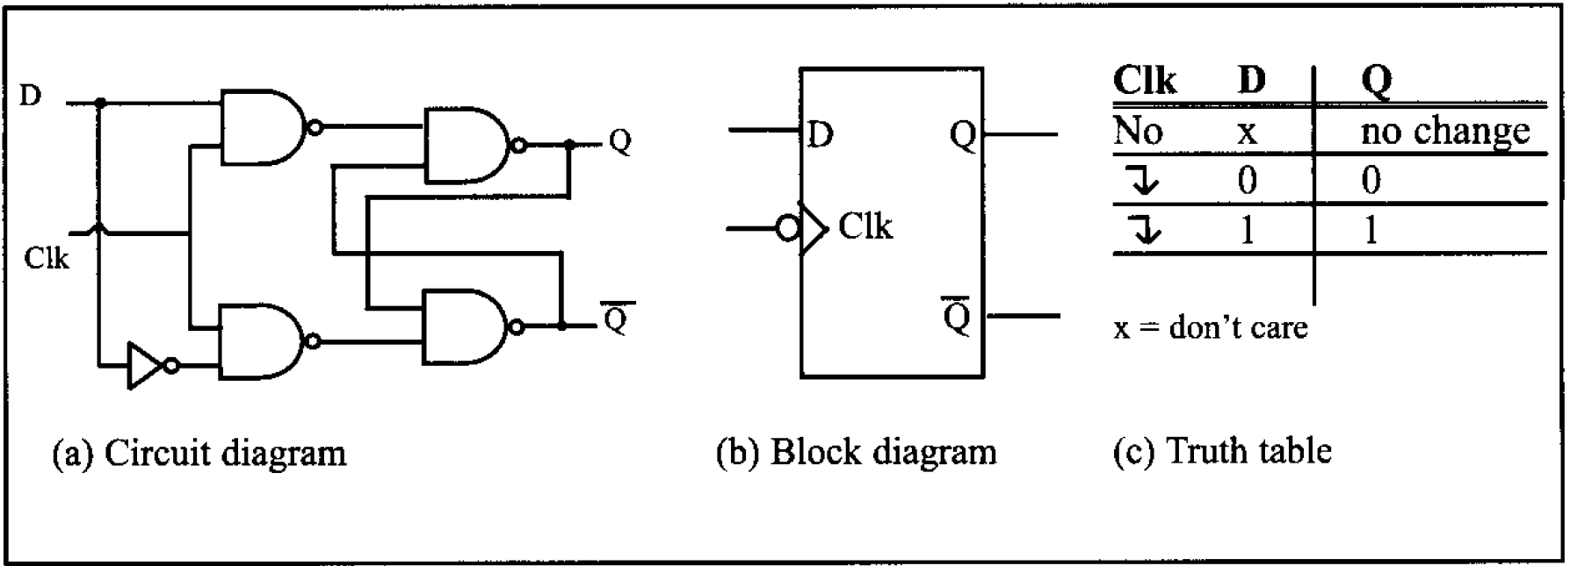
Logic design using gates
Flip Flop

Slide 9
Memory organization
ROM (read only memory)
PROM (programmable ROM – burn information into)
EPROM (erasable programmable ROM)
EEPROM (electrical erasable programmable ROM)
Flash memory EPROM
RAM (random access memory)
SRAM (static RAM)
DRAM (dynamic RAM)

Slide 10
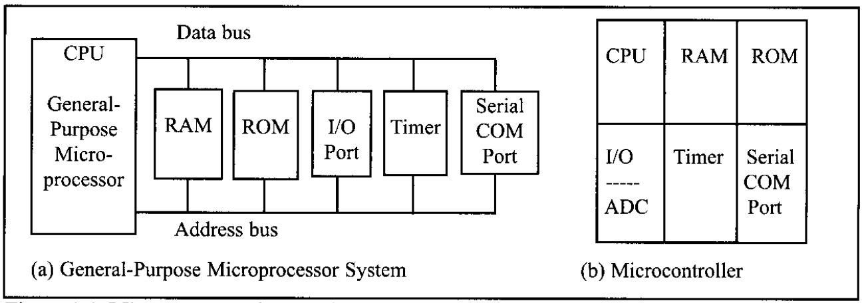
Inside a microprocessor

Slide 11
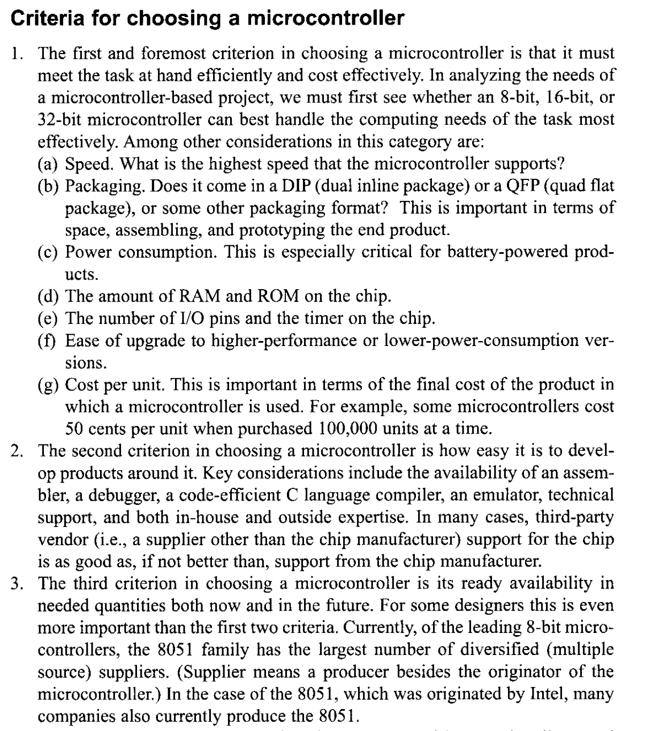

Slide 12

Overview of AVR family
a brief history of the AVR microcontroller
Alf-Egil Bogen and Vegard Wollan
Norwegian Institute of Technology (NTH)-1990
What AVR stand for ? Atmel say nothing but the product name
Advance Virtual RISC
Alf and Vegrad RISC

Slide 13
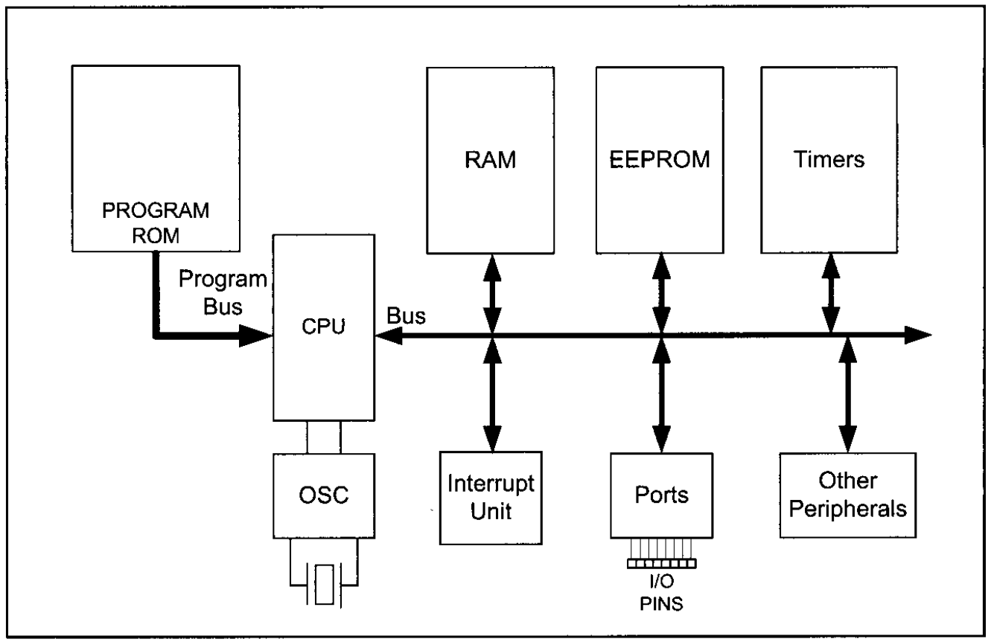
Overview of AVR family
AVR feature
memory, I/O, timer, ADC, PWM, UART, I2C, SPI, CAN, USB,…

Slide 14
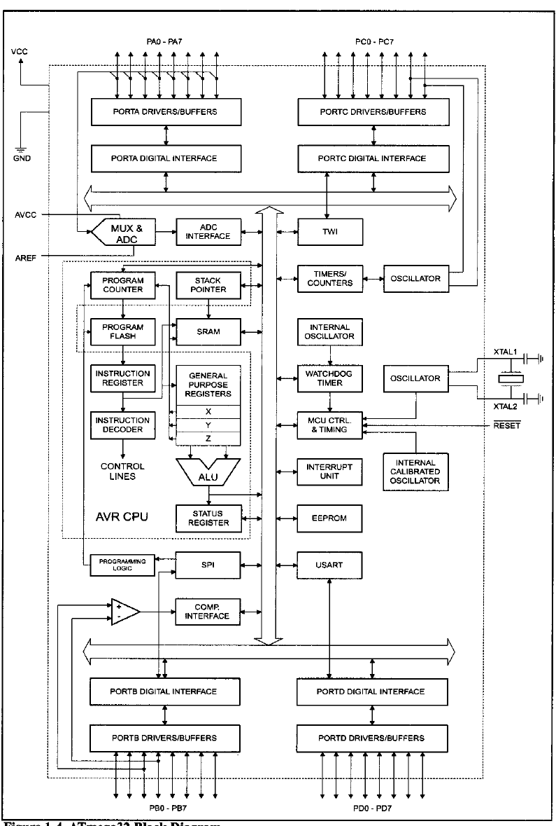
Inside ATmega32

Slide 15
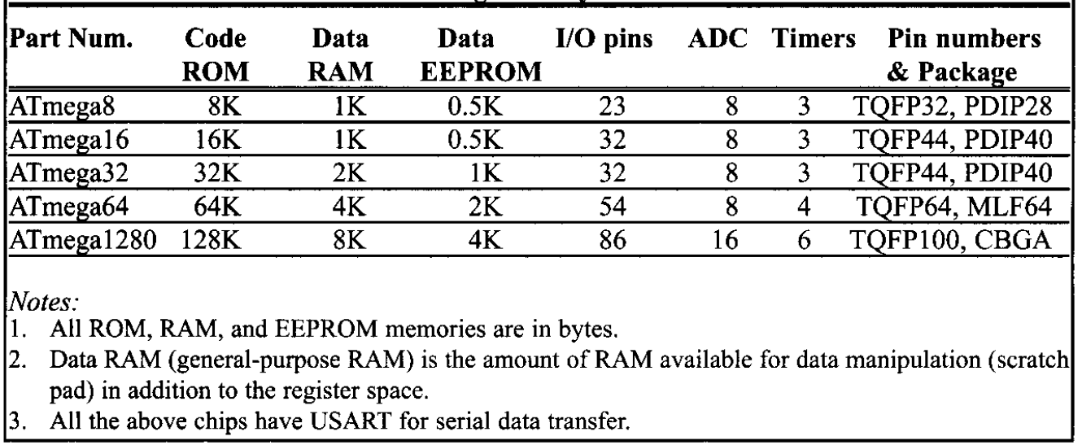
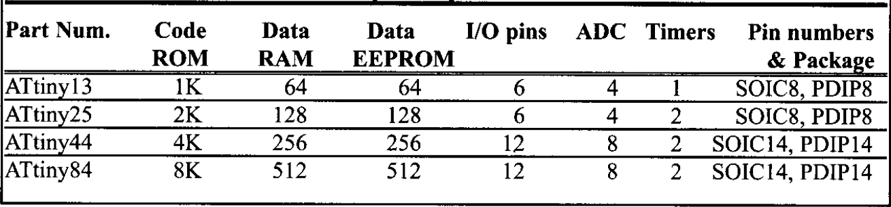
AVR family overview

Slide 16
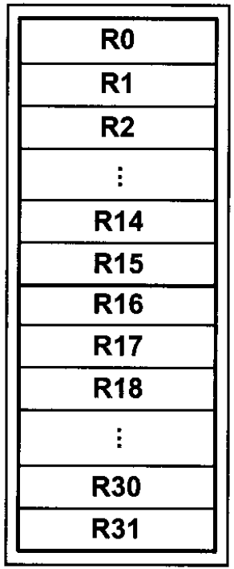
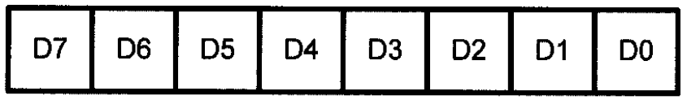
The general purpose REGISTERs in AVR
GPR

Slide 17
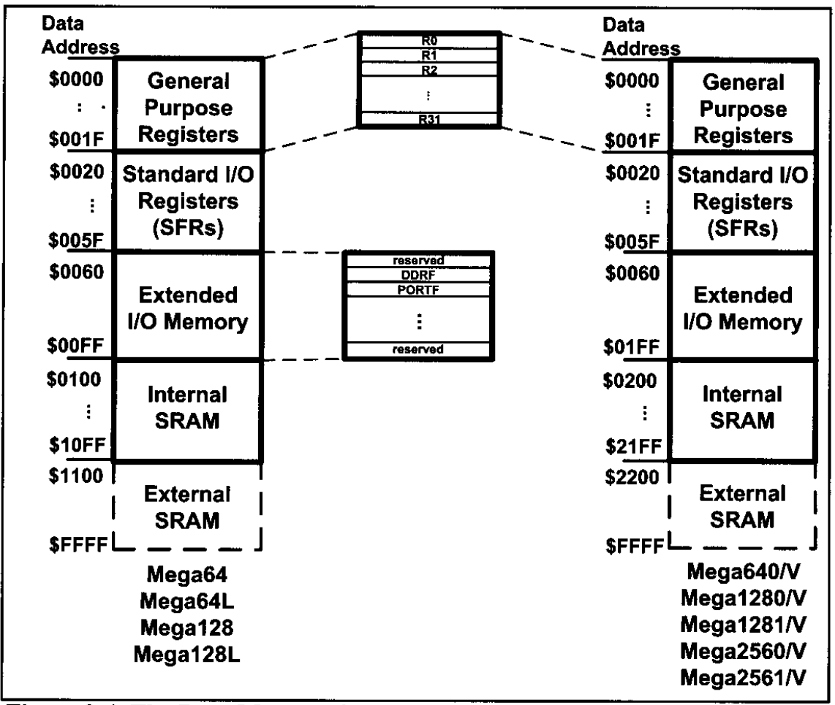
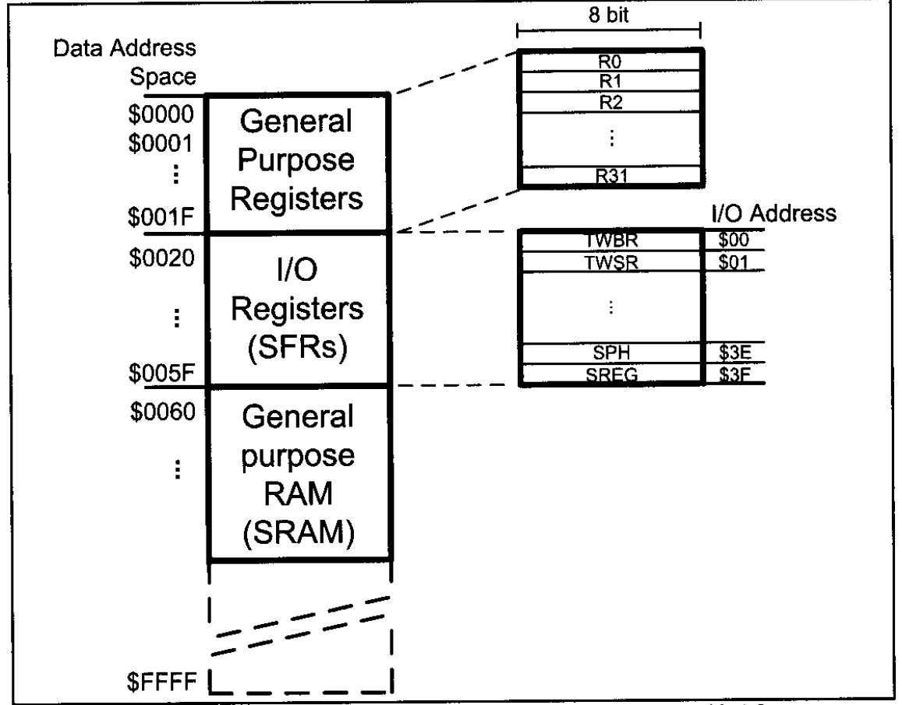
AVR data memory

Slide 18
Software and Driver Installation

